Slide 1
CUCUMBER –Java POC https://github.com/lilaram/POCCucumber
Developed By
Lilaram Anjane

Slide 2
Tools & other stuff Used
Repository→ Github
Build Tool→ Maven
Design pattern→ Page Object Model
Programming Language→ Java
CI Tools-> Jenkins
Other frameworks-> Log4j, Junit
Reporting-> cucumber reports & HTML maven reporting for cucumber.

Slide 3
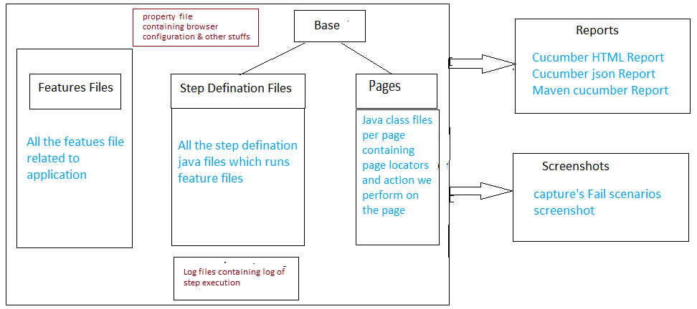
Diagrammatic Overview

Slide 4
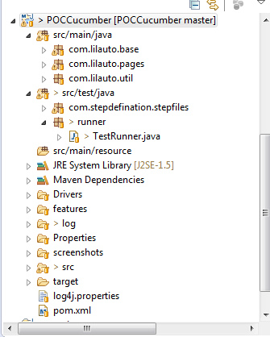
Projects Structure-Eclipse

Slide 5
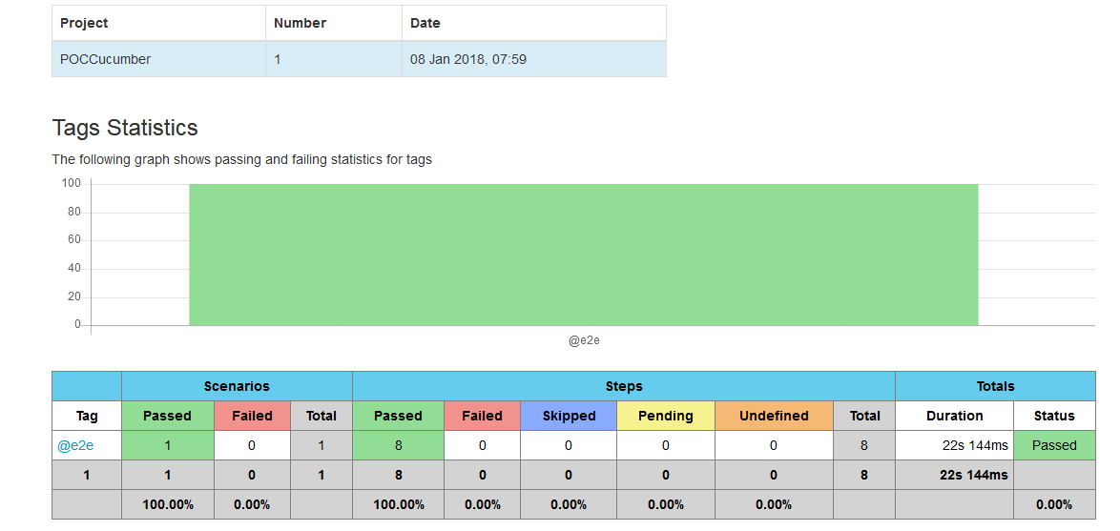
Snapshot-> HTML maven report for cucumber

Slide 6
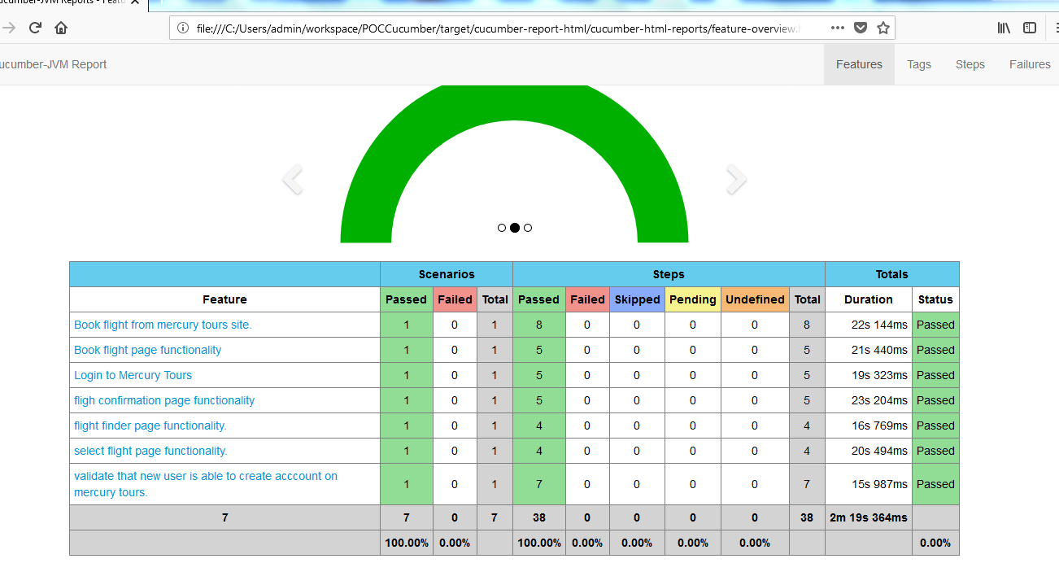
Snapshots-2

Slide 7
Download project from Github
https://github.com/lilaram/POCCucumber

Slide 8
Thank you

